Slide 1

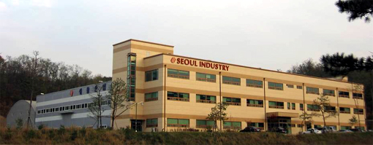
Since 1985
Phone: +82-31-366-1141 Fax: +82-31-366-1150 E-mail: sales@seoulind.co.kr
#1004-1 Shinwang-ri Yanggam-myun Hwasung-shi, Kyonggi-do, Korea
TS 16949 ISO 14001

Slide 2

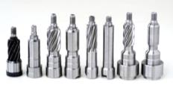

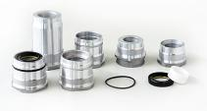

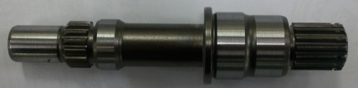
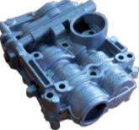


Agenda
1. | Vision & Target | - - - - - - - - - - - - - - - - - - - - | 4
2. | Company Profile | - - - - - - - - - - - - - - - - - - - - | 5
3. | History | - - - - - - - - - - - - - - - - - - - - | 6
4. | Organization chart | - - - - - - - - - - - - - - - - - - - - | 7
5. | Major customers | - - - - - - - - - - - - - - - - - - - - | 7
6. | Annual sales revenue | - - - - - - - - - - - - - - - - - - - - | 8
7. | Main production line & products | - - - - - - - - - - - - - - - - - - - - | 9
8. | New development programs | - - - - - - - - - - - - - - - - - - - - | 17
9. | R&D Capability | - - - - - - - - - - - - - - - - - - - - | 18
10. | Inspection equipments | - - - - - - - - - - - - - - - - - - - - | 19
11. | Certificates | - - - - - - - - - - - - - - - - - - - - | 22

Slide 3
1. Vision & Target
Integrated Precision Machining Supplier in Global Automotive Industry
Integrated
Process
Cost
Competitiveness
Advanced
R&D
Enhanced
Quality System
Turning
Facing
Milling
Broaching
Drilling
Heat Treatment
Grinding
Burnishing
Hobbing
Skiving
Polishing
…
Automated
Production Line
Optimized Processes
Alternative Process
SCM Control
Capabilities for
Material, Part, Process
Development
APQP
Guest Engineering
Global Standard
TS16949
ISO14001
SQ Mark
Customer Oriented
Quality System
Poke Yoke

Slide 4
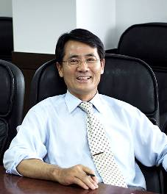
2. Profile
Establishment: May 20, 1985
Business career in automotive industry: 29years
Business policy: Harmony, Creation
Address: #1004-1 Shinwang-ri Yanggam-myun Hwasung-shi, KyungGI-do, Korea
Phone: +82-31-366-1141
Fax: +82-31-366-1150
Home Page: www.seoulind.co.kr
E-mail: sales@seoulind.co.kr
Capital: US$1,500,000
DUNS Number: 68-871-9392
Employees 185 in total
Annual sales revenue: US$49Mil / Year 2013
Land in SQ. FT. 250,000 Plant in SQ.FT. 100,000
We are trying to be
the best supplier for customer’s satisfaction
at precision machining automotive industry.
Kim, EulSik / CEO

Slide 5
3. History
1985: Established as “Seoul Precision, Inc.”
1987: Registered as supplier of TRW Korea (TSCL)
2001: Obtained QS9000/ISO9002
2002: Registered as supplier of Korea Delphi Automotive Corporation
2003: Appreciation award from TRW Asia Pacific Purchasing.
2003~2004: Registered as supplier of TRW Japan & TRW America
2004: Obtained ISO/TS16949
2004: Registered as supplier of Metaldyne in US & Korea
2006: Plant Moving (250,000sq. ft size in land / 10,000sq. ft size in building)
2007: Registered as supplier of Nexteer in China
2008: Registered as supplier of ThyssenKrupp in US, China & Germany
2008~2009: Registered as supplier of Magna PowerTrain – NPG & STT
2009: Registered as supplier of Hyundai Mobis
2011: Awarded the 10Mil. Export Prize by Korea International Trade Association
2013: Obtained HMC SQ –MARK
2013: Registered as supplier of GKN Driveline – Japan, Italy

Slide 6
4. Organization – Changes from small organization to mid-size and Quality Focused
CEO
COO
CFO
R&D Center
Sales
Quality
Control
Production
Procurement
Finance
General
Affair
Development
Customer Satisfaction
Quality
Control
Production
Procurement
Finance
General
Affair
Manufacturing
Engineering
Oversea/Dom.
Sales
Quality
Assurance
Maintenance
Supplier
Management

Slide 7
5. Customer
Region | Customer | Country
Global Market | ThyssenKrupp | US, China, Germany
 | Magna Powertrain UMG, NPG, APT, STT, Pullmatic | Canada, Mexico
 | Metaldyne | US
 | Spartan | US
 | TRW | Japan
 | GKN Driveline | Italy, Japan
 | Nexteer | China
Domestic Market | Metaldyne Korea
 | TRW Korea
 | Korea Delphi
 | Hyundai Mobis
 | MyungHwa

Slide 8
6. Sales Revenue
$24Mil
$20Mil
$29Mil
$41Mil
$46Mil
$49Mil
$56Mil

Slide 9
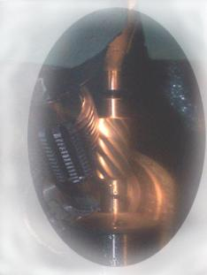
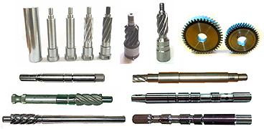

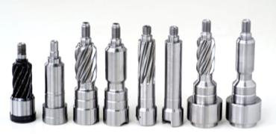

7. Main Production Line and Products
Pinion Shafts Assembly
Forging
CNC turning
MCT Machining
Thread Rolling
Hobbing
Carburizing or Induction Hardening
Hard Hobbing /Skiving
Assembly
Hobbing Skiving
TRW, Mobis, Nexteer, KDAC
Steering - Pinion Shaft assembly
Over 100 different part numbers for all major Steering system suppliers in Korea

Slide 10
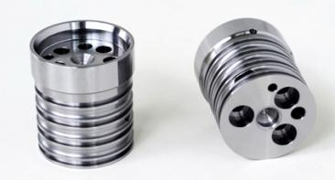
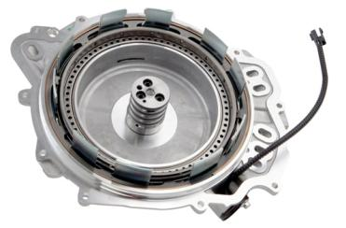
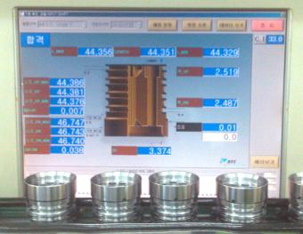
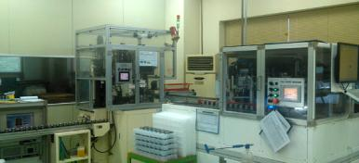
7. Main Production Line and Products
Input Shaft Hub for Transmission
Bar Stock & QT
CNC Turning
MCT Drilling
Side End Milling
Burnishing
Deburring
Ultrasonic Washing
100% Auto Inspection
End cover assembly at customer
Metaldyne, Spartan for GM/Ford X22F
Auto inspection data
Auto inspection & Poke yoke
Over 1.2Mil pcs/year for X22F 6 Speed Auto Transmission of GM/Ford

Slide 11
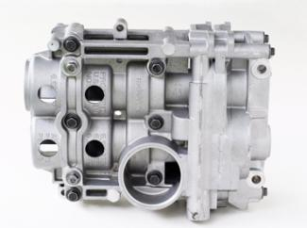
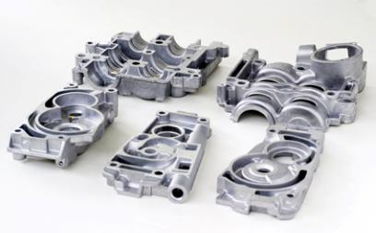
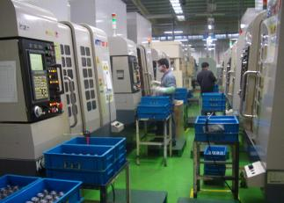
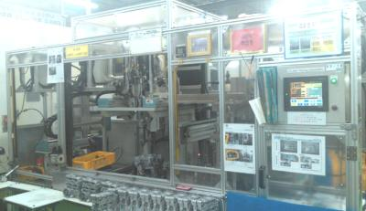
7. Main Production Line and Products
Balance Shafts Module Housing
Al. Die Casting
Component MCT Machining
Housing Assembly
Assembly Machining
Washing
Auto Inspection
Metaldyne, MyungHwa for HMC
Machining line
Assembly Line
For Hyundai Motors major application / Over 3.5Mil pcs a year

Slide 12

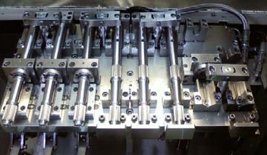
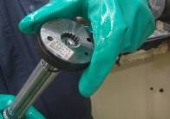
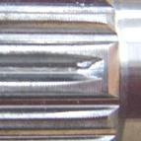
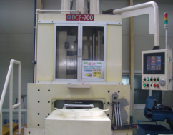
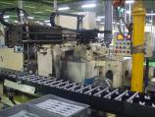
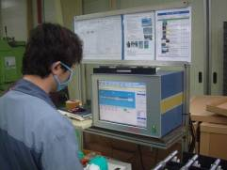
7. Main Production Line and Products
Actuator Shaft
Bar Stock
CNC Turning
Rack Rolling for Blocked Teeth
MCT Machining
Auto Inspection
Washing & Packing
Grinding
MCT Machining
Blocked teeth
Spline control
Magna – NPG
Gear Roll Forming M/C
Grinding
Auto inspection
VAVE new process for double teeth

Slide 13
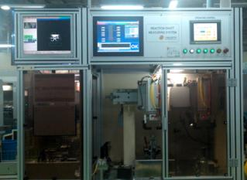
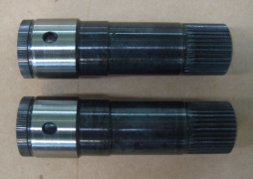

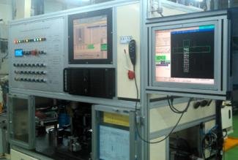
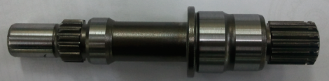
7. Main Production Line and Products
GF6 Gen II & III Pump Shafts
Forging
CNC Turning
Rolling
Drilling
Hobbing
Induction Hardening
100% Auto Inspection
Grinding
Gen II
HD Auto inspection
Gen III
Magna - STT
SD Auto inspection
Exclusive production line for Gen II & Gen III over 1Mil capacity

Slide 14
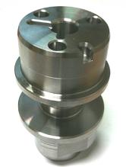
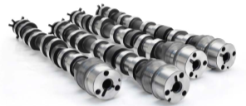
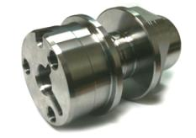
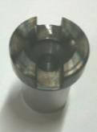
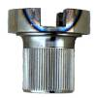
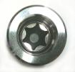
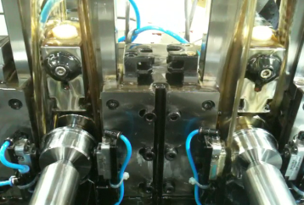
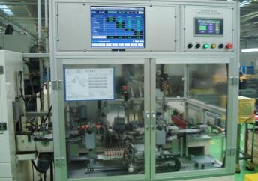
7. Main Production Line and Products
End Pieces
Bar Stock
CNC turning
Rack Rolling
MCT Machining
Auto Inspection
Washing & Packing
Customer Camshaft assy
ThyssenKrupp Presta
Exclusive broaching process
100% auto inspection
Exclusive production line over 700k capacity

Slide 15
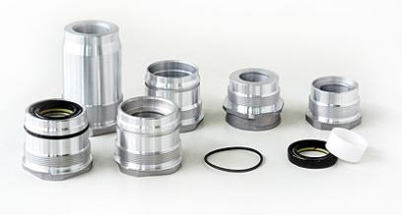
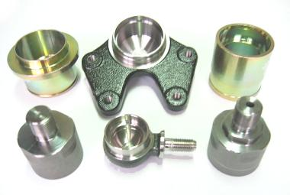
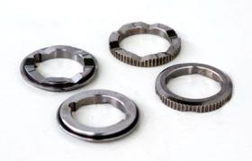
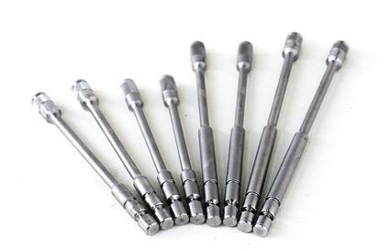
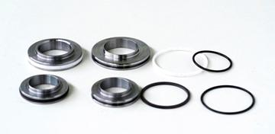
7. Main Production Line and Products
Torsion bar, Rack Bush, Piston, Reaction Plate
Die Casting / Sintering
Shot Peening
Form Grinding
Assembly
Washing & Packing
CNC Turning
TRW, KDAC, Mobis
Steering assembly components / Preparing assembly parts supplying

Slide 16
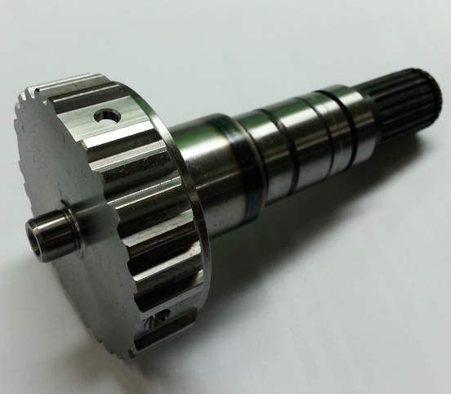
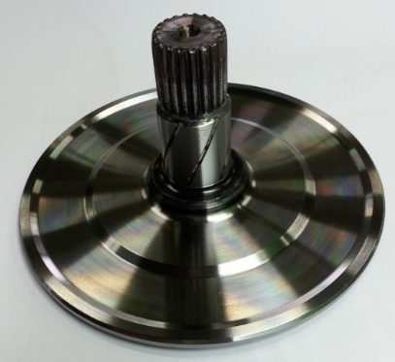
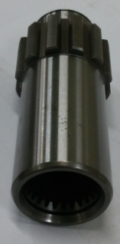
7. Main Production Line and Products
GKN-V5
GKN-V5
GKN-EM8B
Inner Disk Carrier
ODC Hub
Hub
Forging
Rolling
Hobbing
Finish Turning
Drilling
CNC turning
Induction
Grinding
Auto Inspection
Forging
Rolling - Groove
Rolling - Spline
Induction
CNC turning
Grinding
Auto Inspection
Forging
Hobbing
Drilling
CNC turning
Carburization
Grinding
Auto Inspection

Slide 17
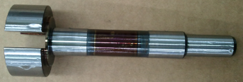
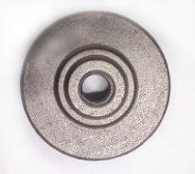
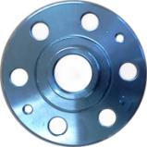
7. Main Production Line and Products
Pump Shaft & Hub
Forging or Cold Forging
MCT Machining
Induction Hardening
Grinding Polishing
Washing & packing
CNC turning
Q.T.
Magna – APT Gen V
Magna – UMG Lada
Marking
Steering assembly components / Preparing assembly parts supplying

Slide 18


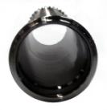
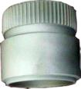
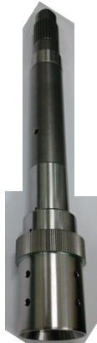



8. New Development Program
X26R - Pump shafts
Transmission clutch module – Output shaft
Short shaft process
Tube SAE513
1st, 2nd CNC turning
Hobbing
3rd turning
FNC heat treatment
Q.T. heat treatment
SOP – 2015
Spartan in IL. US SOP – 2014 GM Toledo, OH

Slide 19
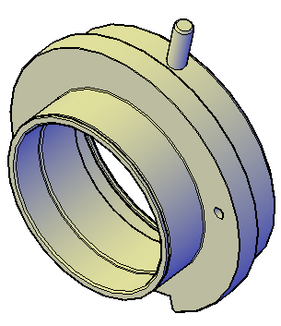






9 . R&D Capability
Material
Simulation
3D modeling
Process
Exclusive M/C
Tooling design
Validation
IPA validation test
GD&T
Specification
Forging
Heat treatment
Heat Treatment
- QT.
- Induction hardening
- Carburizing
- FNC
Forged spline
3D modeling
Steering pinion shaft assy validation test
Hob regrinding
Universal tester

Slide 20








10. Inspection Equipment – GD&T
CMM (X2)
Auto Gear measuring Machine
Run out gage
Contour measuring
Overview of inspection room
Phase angle inspection M/C
Roughness tester

Slide 21







10. Inspection Equipment – Metallurgical, Etc
Micro Vickers
Cleanliness test
Polishing
Rockwell hardness tester
Overview of inspection room
Inspection equipment
Q’ty
Inspection equipment
Q’ty
CNC Gear measuring M/C / Manual type
1/1
CMM
2
Contour Measuring M/C (surface finish tester)
1
Rockwell hardness tester
1
Projection projector
2
Roughness tester
3
Magnetic particle detector
1
Circularity Inspection M/C
1
Micro Vickers tester
1
Universal tester
1

Slide 22









10. Inspection Equipment – Inline Auto Inspections
Input shaft hub
Coyote End pieces
Intermediate shaft
Actuator shafts
Grinding parts auto gage
GF6 shafts
GF6 Double teeth inspection
Pinion shaft auto straightness adjuster
Secure more reliable quality

Slide 23





11. Certificates

Slide 24

12. Latest News
2013.11: Build New Storages
2014.07: Purchased additional plant & office building from the neighbor

